Slide 1
Blockchain in Rust
By Bernard Wong & Mindaugas Sarskus

Slide 2
Introduction

Slide 3
The project
More research based.
Learn Rust Programming Language and Blockchain technology.
To demonstrate and visualize the project, we built a Rust messaging application based on the Blockchain technology concept.
We used:
Rust programming language (Cargo package management tool)
Blockchain technology concept
GitLab
Docker
Rocket
Vue.js

Slide 4
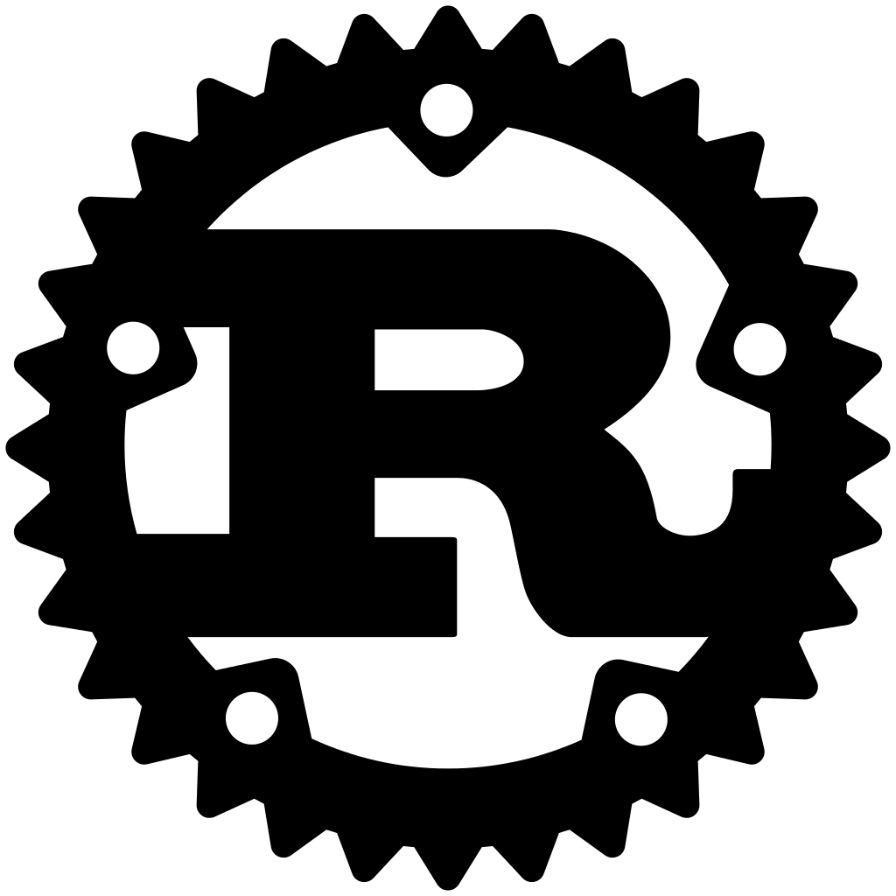
Rust Programming Language
Notes:
Add image somware

Slide 5

What is Rust?
Released in 7th July 2010.
Low level programming language.
Syntactically similar to C++.
“Most loved programming language” for 4 years since 2016.
Designed to provide better memory safety while maintaining high performance.
Package management tool “Cargo”.
Still maturing, but there is strong community support.
Ferris the crab

Slide 6

Rust Features
Memory Management
Ownership system
Borrowing and lifetime mechanism
No Garbage Collection
Speed
What makes Rust so special?
Cargo package manager
Companion packaging system
Manage dependencies
Compiles packages
Upload package to community package registry

Slide 7
Rust Disadvantage
Documentation is not newbie friendly
Still maturing, unstable libraries
Complexity
What makes Rust bad at?

Slide 8
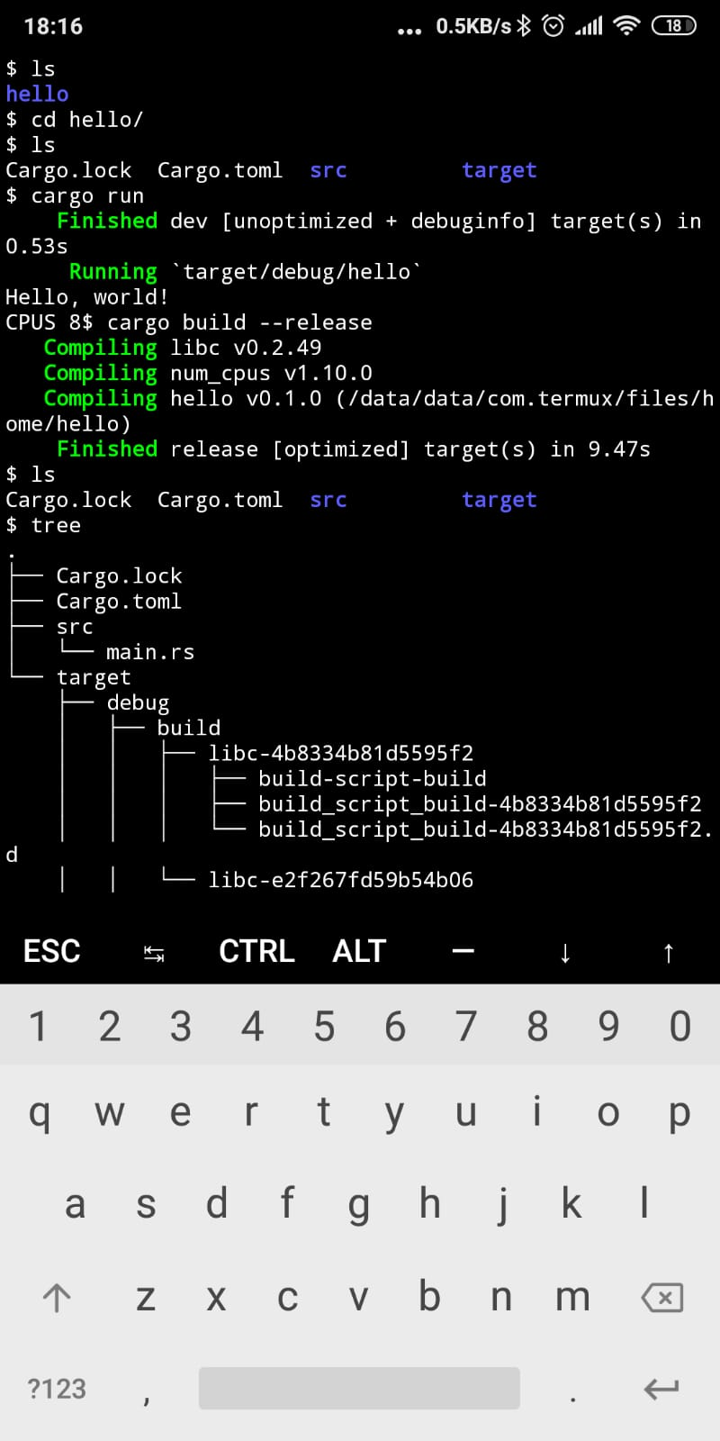
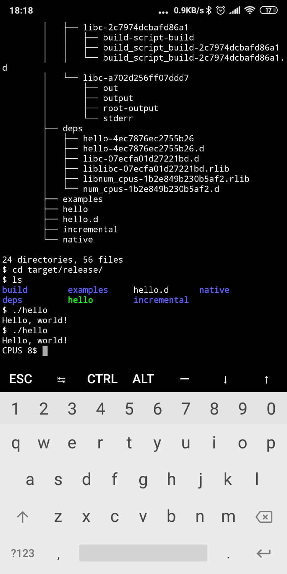
Rust on android mobile phone
Compile and run cargo
Build release

Slide 9
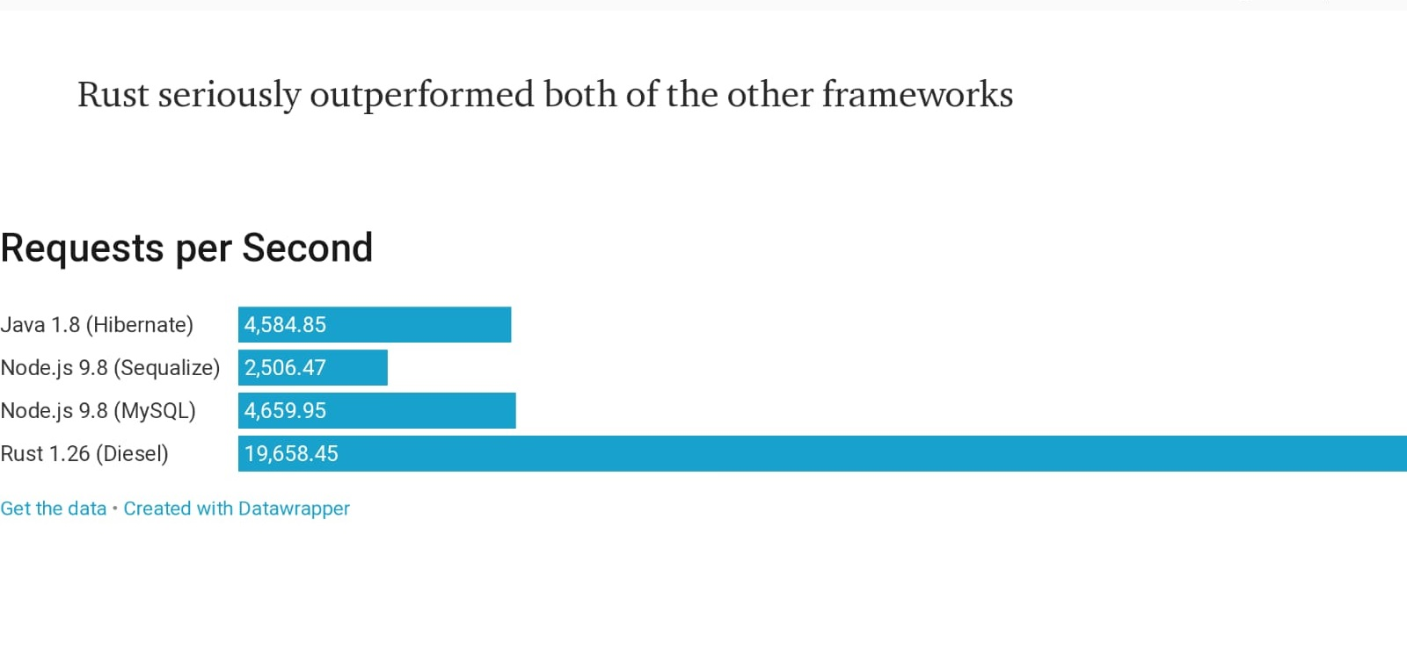
Rust performance
More examples: Parsing logs 230x faster with Rust

Slide 10

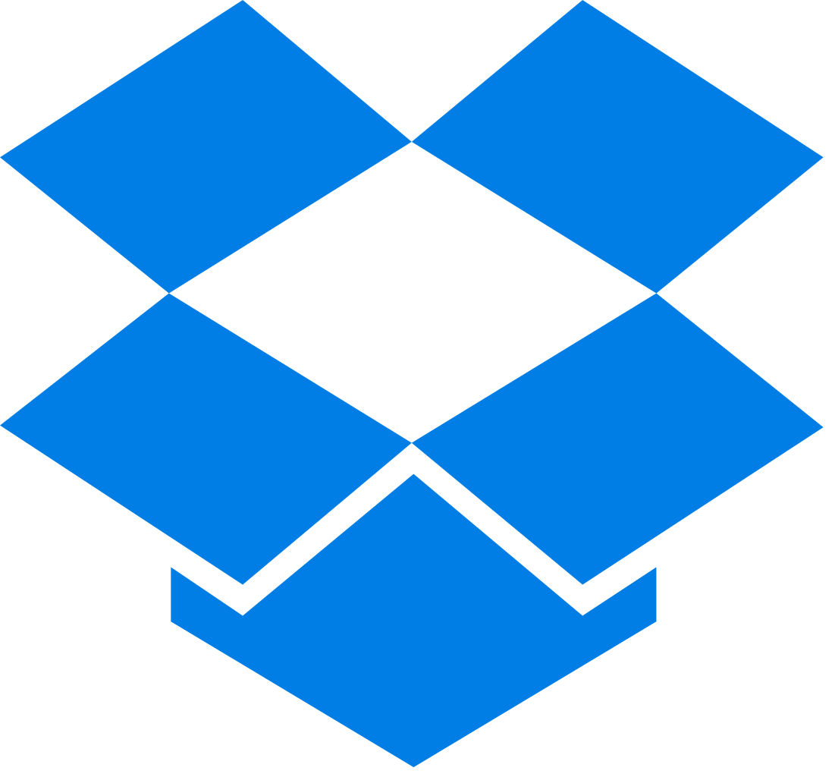
Companies that use Rust
Mozilla
Migrating our Push connection infrastructure to Rust has provided us with an easier to maintain code-base with a focus on correctness while delivering fantastic performance. We are now handling up to 20 million websocket connections at once during peak hours with Rust servers.
The JavaScript implementation [of the source-map library] has accumulated convoluted code in the name of performance, and we replaced it with idiomatic Rust. Rust does not force us to choose between clearly expressing intent and runtime performance.
Dropbox
[Rust’s] properties make it easy to embed the DivANS codec in a webpage with WASM, as shown above.
Several components of the Dropbox core file-storage system were written in Rust as one step in part of a larger project to pursue greater datacenter efficiency. It’s currently used by all Dropbox storage today, serving >500 million users.

Slide 11
Why do we choose Rust?
“A language that doesn't affect the way you think about programming, is not worth knowing.” - Alan Perlis (Epigrams on Programming, No. 19)
Try something new
Challenging and unique
Interesting memory management concept
Some developer’s thoughts

Slide 12
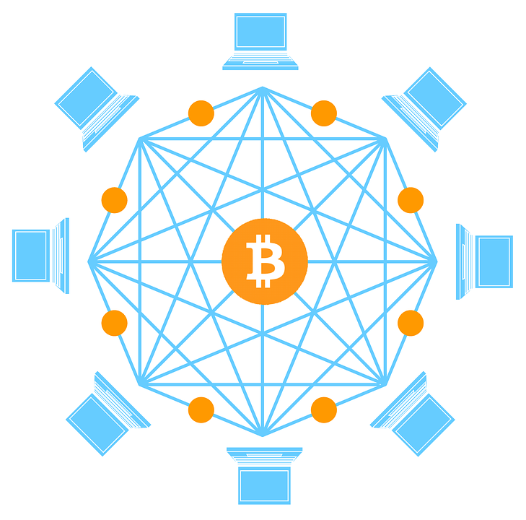
Blockchain

Slide 13
Blockchain Technology
Invented by a person/group of people using the name Satoshi Nakamoto.
Serve as the public transaction ledger of cryptocurrencies.
A simple yet ingenious way of passing information from A to B in a fully automated and safe manner.

Slide 14
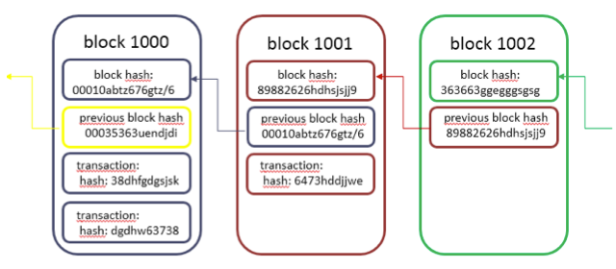
The Blockchain
Block
Data
Hash
Hash of previous block
Act as a database
Decentralized and distributed
Cannot be altered easily

Slide 15

Why is Blockchain safe?

Slide 16
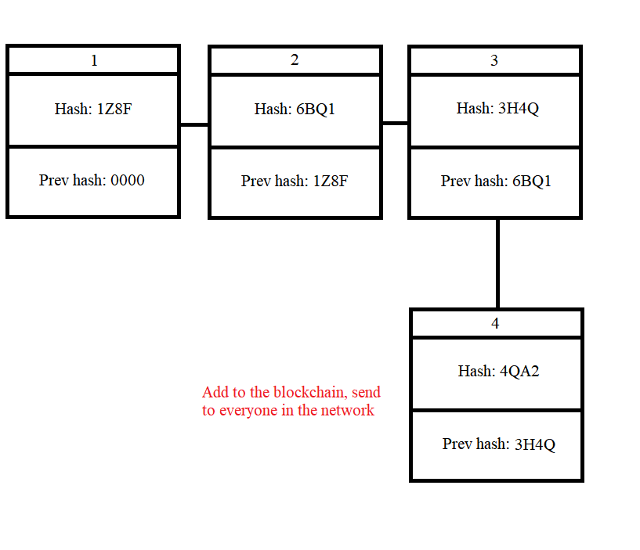
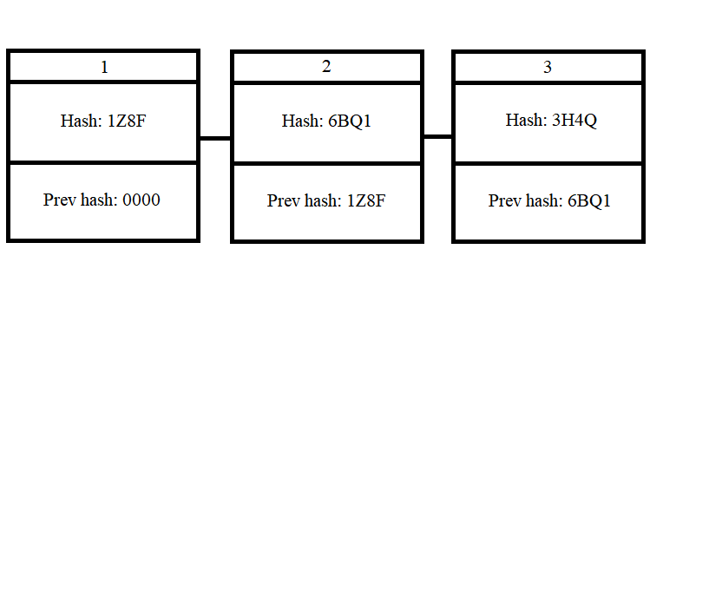
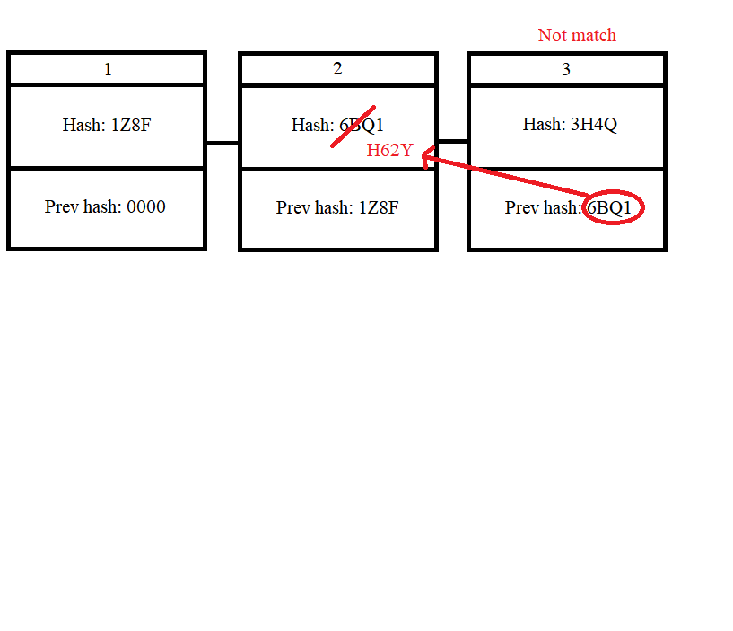
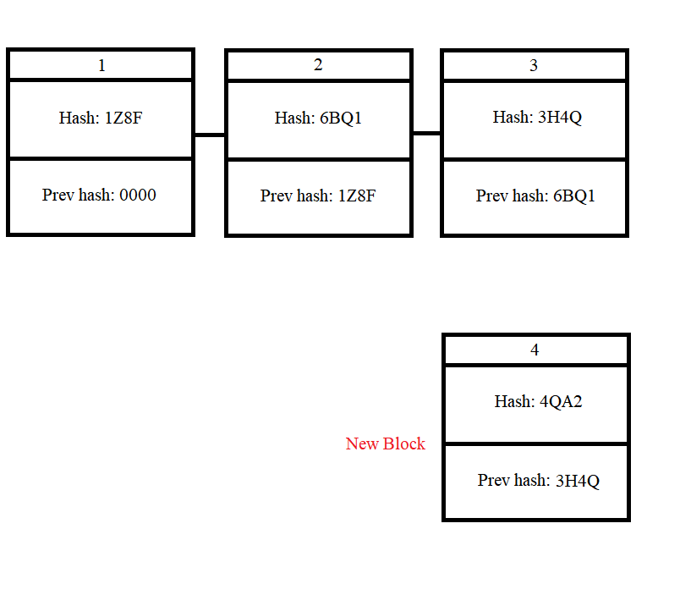

Slide 17
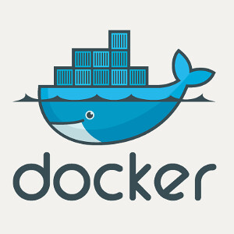
Docker

Slide 18

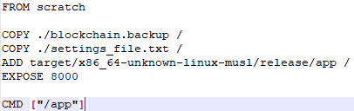
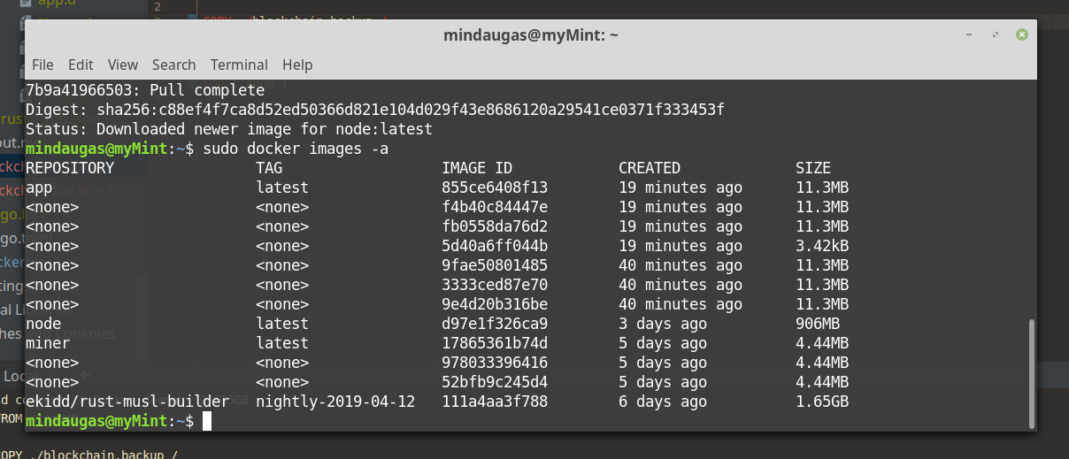
What is docker?
Linux container technology that package and ship applications and run on existing hardware.
Similar to VM but different:
Virtualize OS kernel, not the hardware.
Cannot run OS.
Do not need to install OS for every application.
Cheap resource.
Easy to duplicate instances.
Docker containers are describe in a file called “Dockerfile”. The Docker engine builds and run the Dockerfile into a Docker image.
A running instance of an image is called a container.

Slide 19
Application Demonstration

Slide 20
Conclusion
What we’ve learned:
Rust is a really complex and hard to learn language.
So is Blockchain.
What it takes to learn new programming language ourselves.
Adapt and improvise problems.
Teamwork organization.
GitLab link: https://gitlab.com/My-/year3_project

Slide 21
Questions?

Slide 22
Thank you very much

